Slide 1
Early Detection Warning Systems and Intensity Estimation for Cyclones
Team 3

Slide 2
Table of contents
01
02
03
04
05
06
07
08
09
Background
Scope
Objectives
Methodology
Results
Demonstration
Conclusion
Future Work
References

Slide 3
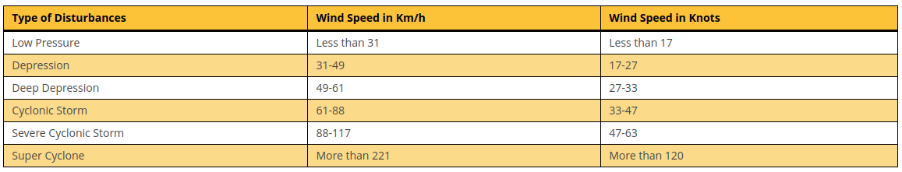
01
Background and Introduction
Cyclones are dangerous storms with high winds and heavy rains that can cause massive damage and affect millions each year. Predicting cyclones allows authorities to issue early warnings to people living in affected areas, giving them time to prepare and take necessary precautions.
Understanding the potential intensity, track, and timing of cyclones enables governments and organizations to implement risk mitigation measures. This reduces the impact of cyclones on both human lives and infrastructure.

Slide 4
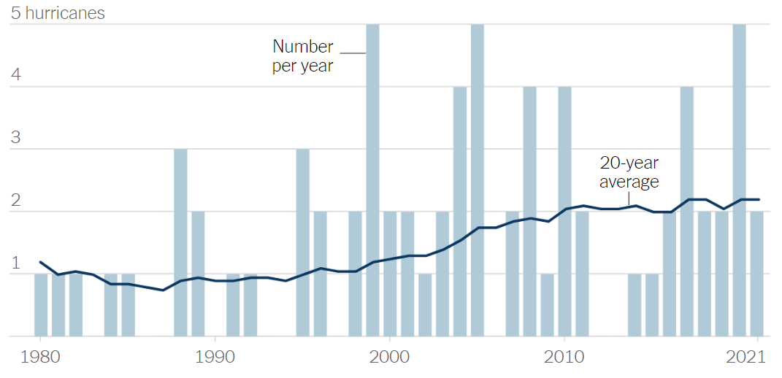
Background
The 20-year average number of annual Category 4+ hurricanes in the Atlantic Ocean has doubled since 2000.

Slide 5




Motivation
Scalability
Data-driven Insights
AI algorithms can scale to handle large volumes of data from multiple sources, allowing for comprehensive analysis of storms over wide geographic areas
Leveraging big data models using large datasets to gain detailed insights, previously unseen by traditional methods.
Automation
Predictive Accuracy
AI models can process data much faster than humans. Automation allows human resources to be better allocated.
AI models can achieve higher levels of predictive accuracy compared to traditional forecasting methods.
‹#›

Slide 6
02
Scope
There are two parts to our project
We collected data from INSAT-3D which is a database of satellite database.
INSAT-3D satellite is part of the Indian National Satellite System, which serves various purposes including telecommunications, broadcasting, meteorology in India.
Temporal scope: 2012 – 2021 for INSAT images
Spatial Scope: Above the Indian Ocean
We have additionally made a model which predicts cyclone based on metadata taken from the NHC’s (National Hurricane Center) database for Hurricanes and typhoons.
Temporal scope: 1851 - 2014
Spatial Scope: Pacific and Atlantic

Slide 7
03
Objectives
To develop an advanced predictive analytics model that leverages the comprehensive INSAT-3D satellite imagery database and NHC Hurricane Database.
By integrating satellite metadata and historical patterns of cyclones, the model aims to provide timely and reliable forecasts, contributing significantly to disaster preparedness and mitigation efforts in the world.

Slide 8
04
Methodology Pipeline
CNN Model Training
Predicting speed of cyclone to classify cyclone
Classification Model Based on metadata and gives early detection stats
Model Pipeline
UI INTERFACING
UI Interface for easy interaction and Updation of DATA

Slide 9
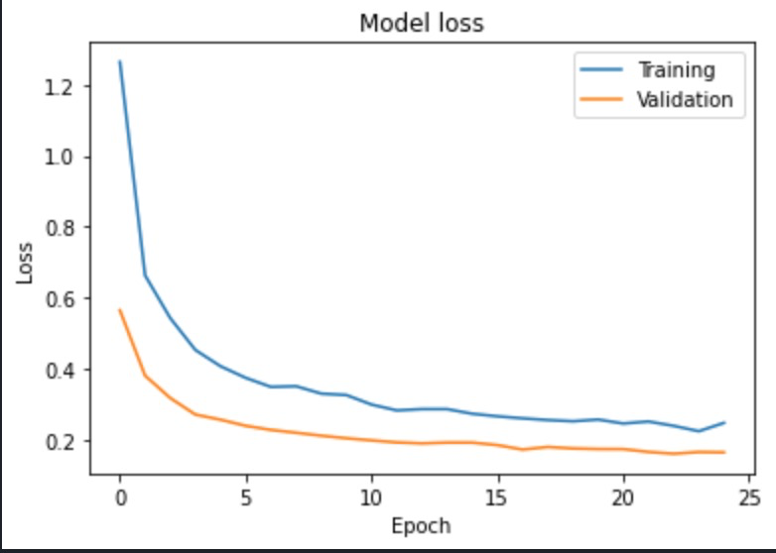
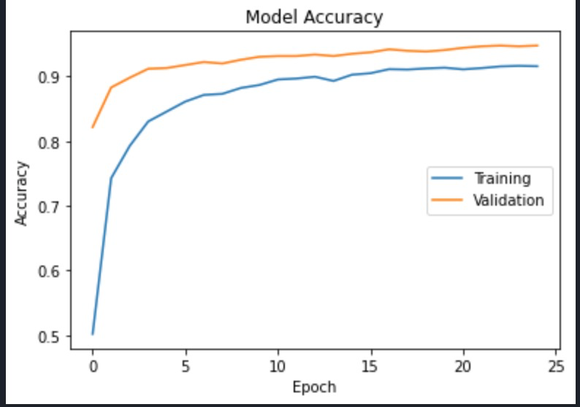
Training Methodology
Training
Split the dataset, train and validate
Modelling
Finding most relevant parameters by feature ranking
Development Methodology
Evaluation and Reusability
Testing, graphing and saving the model

Slide 10
UI Methodology
Frontend and Backend
Implemented Basic Structure and Functionality
Integration
Integration of Saved Model Fields with Frontend for Predictions
Development Methodology
User Interface
Improving and Re-calibrating the interface

Slide 11
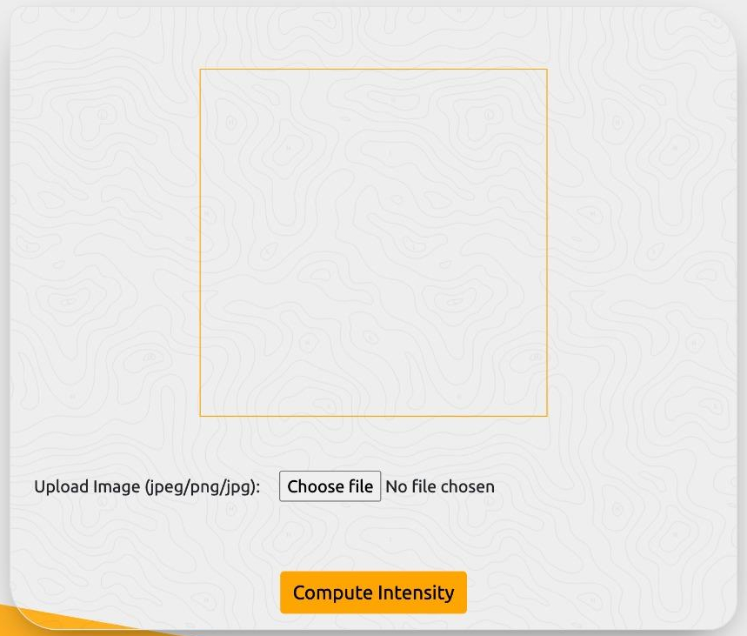
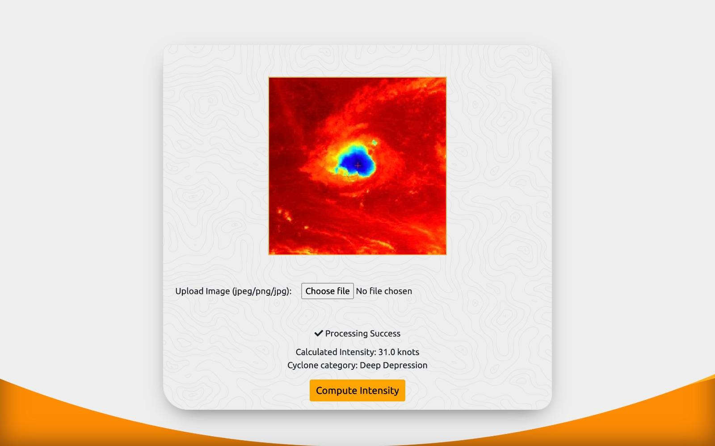
05
Results
The Convolutional Neural Network (CNN) used for the task of satellite images was rigorously tested
The CNN regression model achieved an accuracy of 82.6%.
This model exhibited negligible Mean Squared Error (MSE), indicating high precision in cyclone intensity prediction.

Slide 12
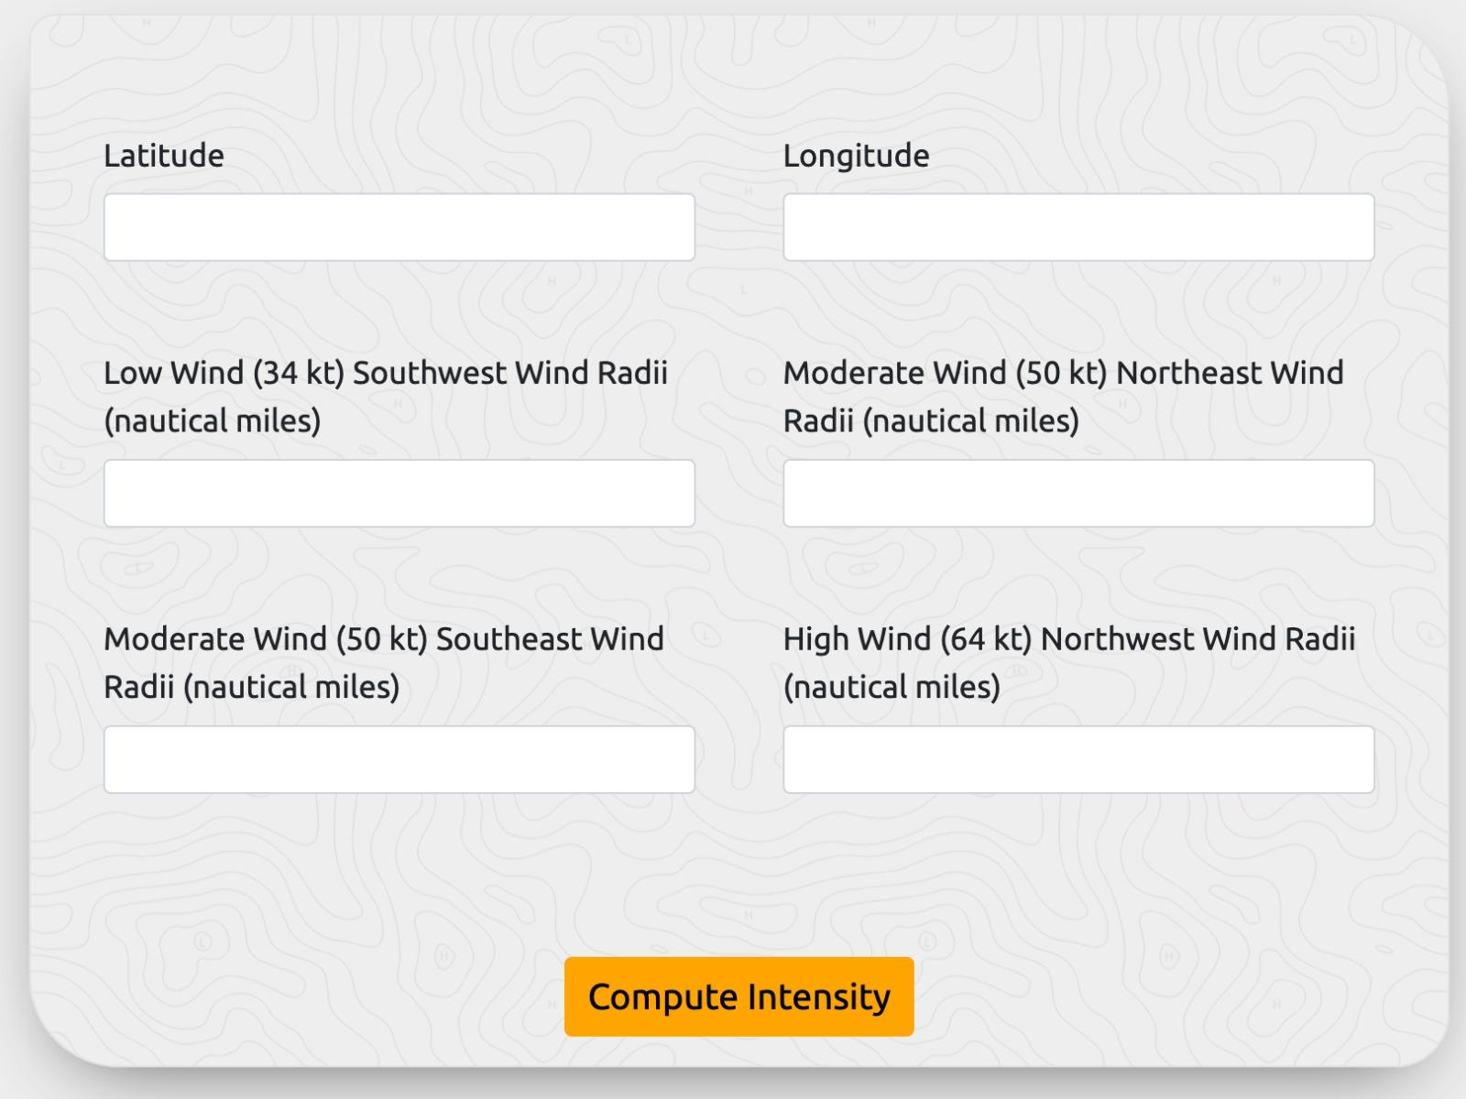
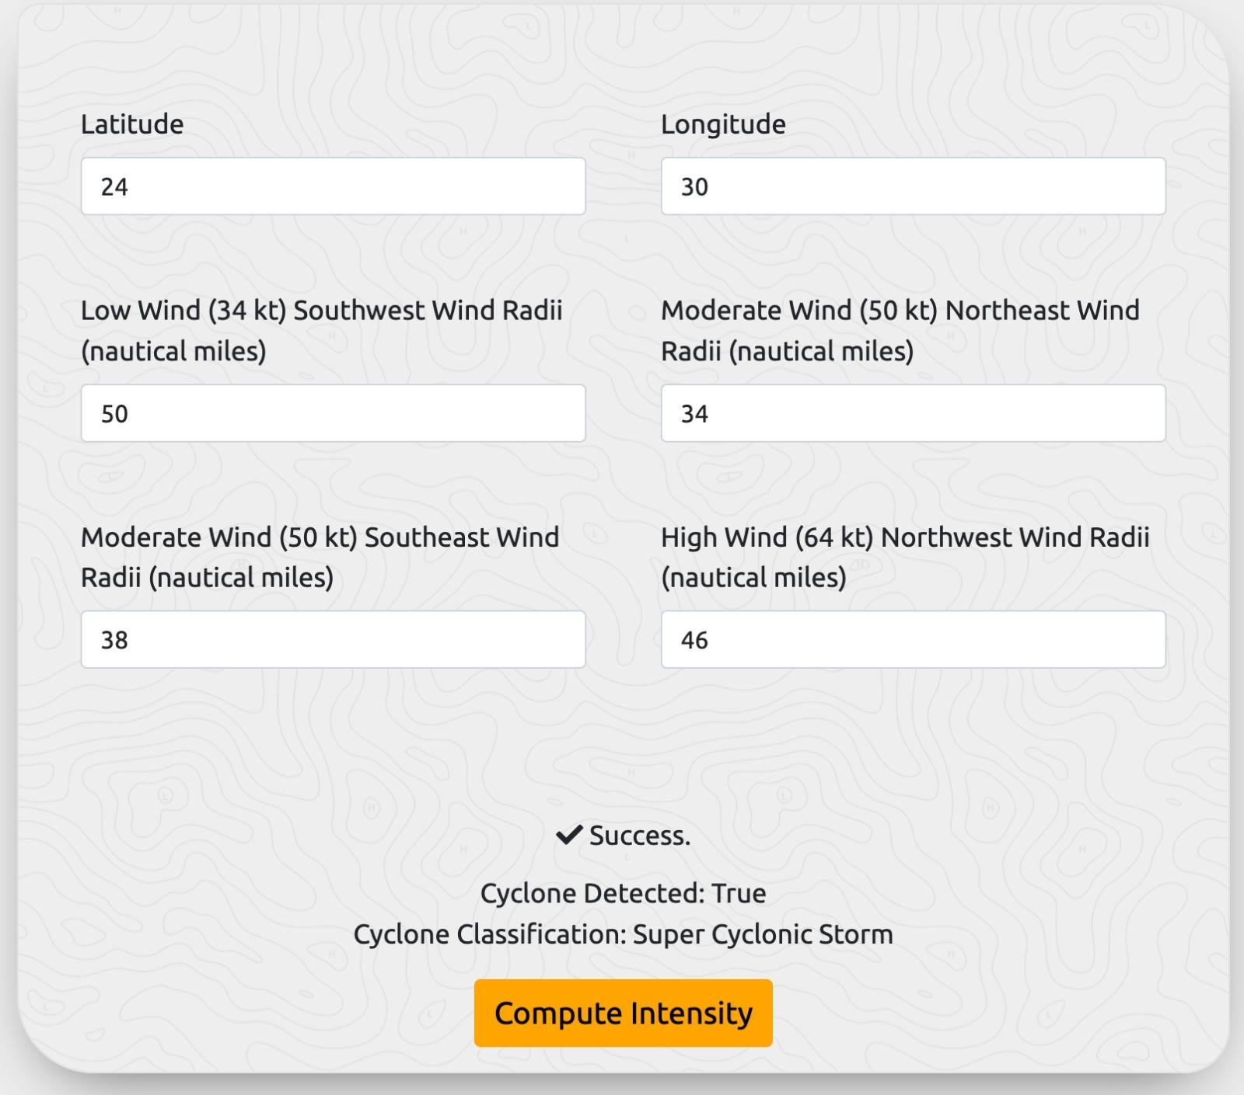
05
Results
The Random Forest Transformer model was rigorously tested and analysed.
The classification model attained a remarkable accuracy of 92%.
This model also exhibited negligible Mean Squared Error (MSE), indicating high precision in classification of cyclone.

Slide 13
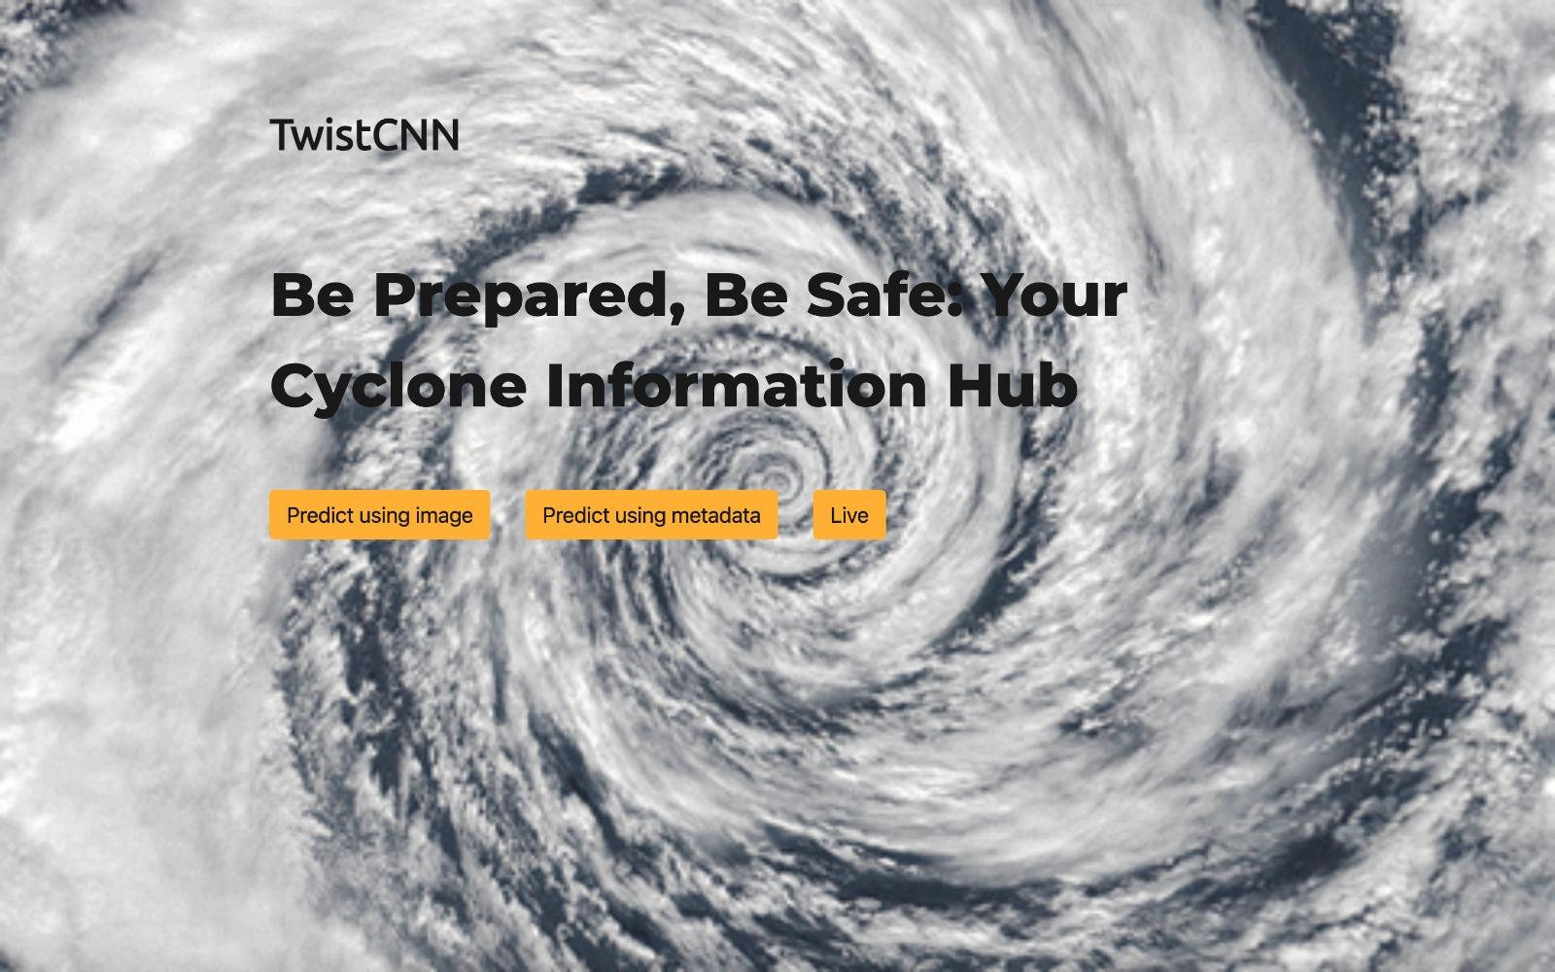
06
Demonstration

Slide 14
07
Conclusion
Early Detection
The Boosted Random Forest is 92% accurate in predicting the category of the cyclone.
Speed Estimation
Our CNN model estimating wind speed using satellite IR imagery achieved an accuracy of 82.6%.
Usability
A graphical user interface enables easy use by non-technical people.
Impact
The models can be deployed to help predict the impact of cyclones-to-be and to estimate their grades.

Slide 15
08
Future work
01
Diversification
Very similar pipelines can be used to detect and aid with other meteorological disasters.
02
Vegetation Indices
The impact of cyclones on vegetation can be tested using NDVI and EVI.
03
Alternative Models
Evaluating GNNs and RNNs for the same problem is a future field of work.

Slide 16
09
References
NOAA Hurricane Database on Kaggle
INSAT 3D Infrared Raw Cyclone Images 2013-2021 on Kaggle
NHC Hurricane Database (HURDAT): The New York Times article
Machine Learning in Tropical Cyclone Forecast Modeling: A Review [MDPI]: https://www.mdpi.com/2073-4433/11/7/676)
Can we use AI to improve the prediction of rapid intensification in tropical cyclones?: https://www.frontiersin.org/articles/10.3389/fmars.2023.1296274

Slide 17
Thank You
Team Members:
Aditya Harikrish (2020111009)
Anusha Nath Roy (2020101124)
Chinmay Pateria (2021114013)
Santhoshini Thota (2021101097)
Srijan Chakraborty (2020115001)
May you not be hit by the cyclone!

